Slide 1


The sfnetworks package
R Ladies Johannesburg – 2 November 2021 – Renate Thiede

Slide 2
Introduction (of me)
PhD student in mathematical statistics at the University of Pretoria
Studying spatial statistics on networks
Working with GIS since 2015
Loves open source, data sharing, etc.
Aim to use open source software and publicly available data as far as possible;
Aim to make my own code and data available as much as I can.
QGIS & R
LinkedIn: https://www.linkedin.com/in/renate-thiede/
ResearchGate: https://www.researchgate.net/profile/Renate-Thiede-2

Slide 3
Outline
Problem statement
Where sfnetworks comes in!
Links and resources for sfnetworks

Slide 4
Problem statement
The problem: analysing road networks.
Routing, distance calculations, accessibility and centrality analyses
There are packages that allow us to work with spatial data, including roads as lines. A popular package is sf, which “represents simple features as records in a data.frame or tibble with a geometry list-column”.
However, sf has limitations when it comes to network analysis, as it does not have graph-like functionality.
There are existing packages that allow us to work with graphs, notably igraph.
However, igraph does not include the spatial aspect.

Slide 5

Problem statement
Code to plot this network structure: https://luukvdmeer.github.io/sfnetworks/articles/preprocess_and_clean.html

Slide 6
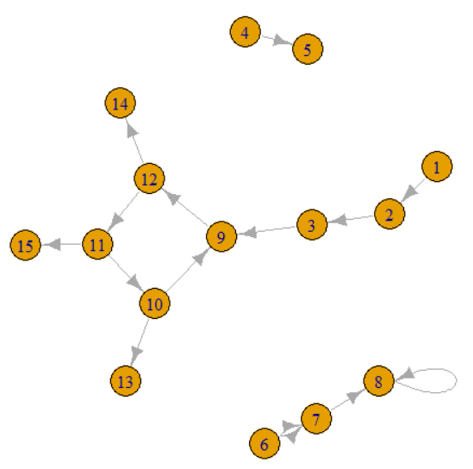
Problem statement

Slide 7
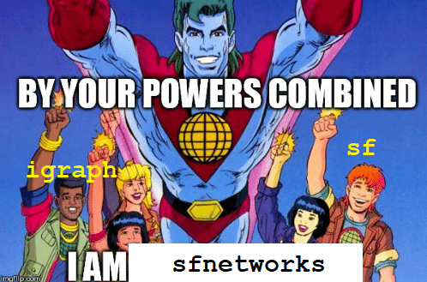
Where sfnetworks comes in!
sfnetworks is a package that essentially allows sf (spatial data) and igraph (graphs) to talk to each other.
It combines the power of spatial data analysis AND graph-based analysis!
Excellent articles on sfnetworks functionality:
https://luukvdmeer.github.io/sfnetworks/articles/

Slide 8
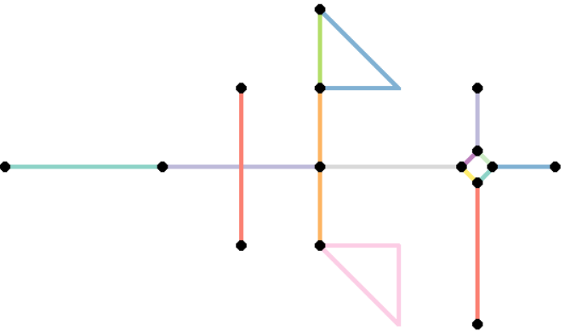
Where sfnetworks comes in!
Code to plot this network structure: https://luukvdmeer.github.io/sfnetworks/articles/preprocess_and_clean.html

Slide 9
The wonderful world of sfnetworks
[Discuss sfnetworks functionality in brief - can follow Luuk’s outline]
[Provide links to sfnetworks GitHub, go to the link & show the cool things that are there]

Slide 10
The wonderful world of sfnetworks: Let’s dive in!
Our example: routing between wards in Gauteng Province, South Africa, using OpenStreetMap data
Download OpenStreetMap data using the osmextract package
Get road network into an sfnetworks object
Clean the road network (NB – preserve distance)
Showcase some sfnetworks functionality: clustering, contraction, routing
How to visualise results – autoplot and ggplot

Slide 11
Links & Sources
sfnetworks:
https://github.com/luukvdmeer/sfnetworks
https://luukvdmeer.github.io/sfnetworks/articles/
sf:
https://r-spatial.github.io/sf/
igraph:
https://igraph.org/r/
osmextract:
https://cran.r-project.org/web/packages/osmextract/vignettes/osmextract.html

